Slide 1
Trend Break Point

Slide 2
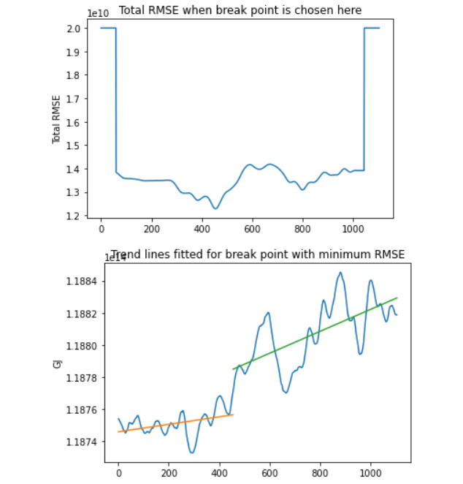
Option 1
Fit a line to the left and right of a trend break point. Move this point accross the graph.
Choose point with lowest RSME for the whole graph.
Result: 1958
+: Feels like an objective and decent method
- Line to the left is clearly not horizontal. This makes it difficult to argue that statistics are constant over this period.

Slide 3
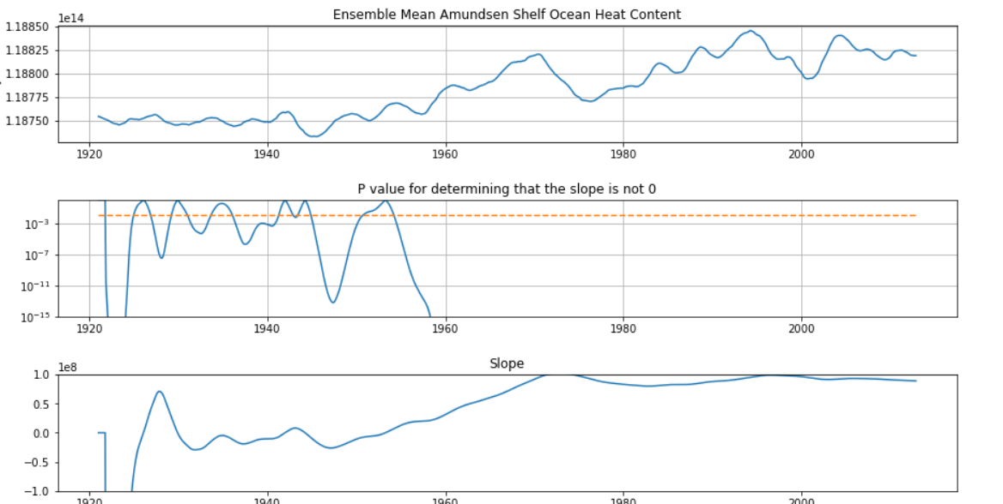
Option 2
Fit a line from the left to a trend break point. Move this accross the graph.
Choose last point where slope is not significantly different from 0 for a certain significance level (here last point where P>0.01)
Result: 1954.
+ Can be argued that this is a sort of constant climate state
- Method feels a bit arbitrary.

